Slide 1

Data Structure and Algorithms-I
Linked Lists
Lecturer Saifur Rahman, Dept. of CSE, United International University

Slide 2
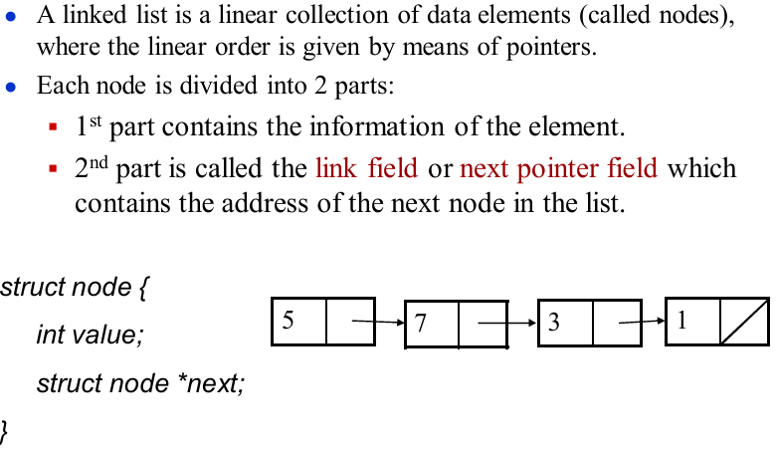
Linked List
Lecturer Saifur Rahman, Dept. of CSE, United International University

Slide 3
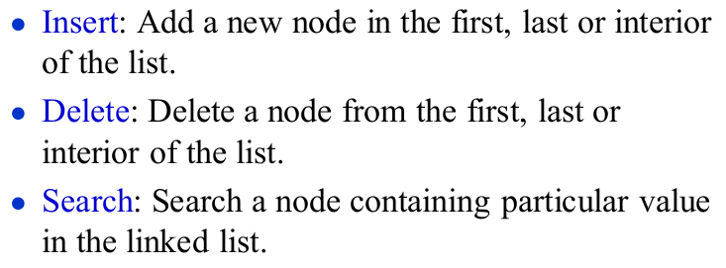
Basic Operations
Lecturer Saifur Rahman, Dept. of CSE, United International University

Slide 4
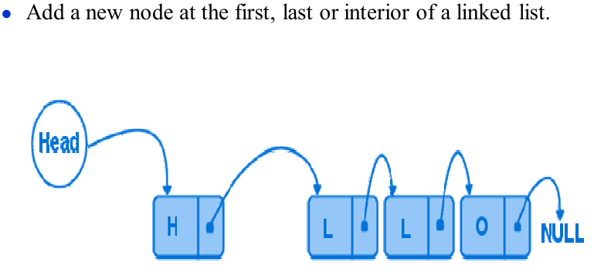
Insertion to a Linear Linked list
Lecturer Saifur Rahman, Dept. of CSE, United International University

Slide 5
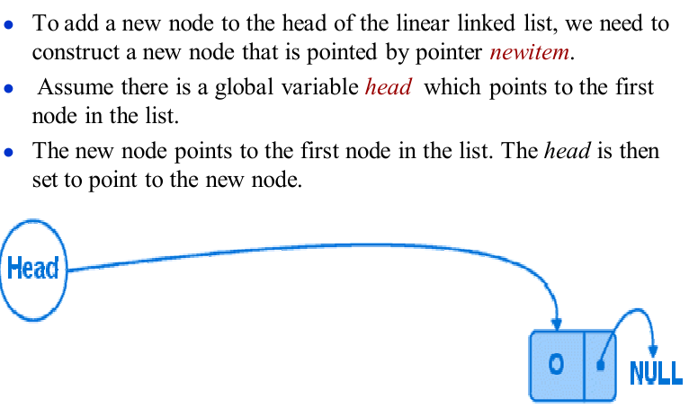
Insert First
Lecturer Saifur Rahman, Dept. of CSE, United International University

Slide 6
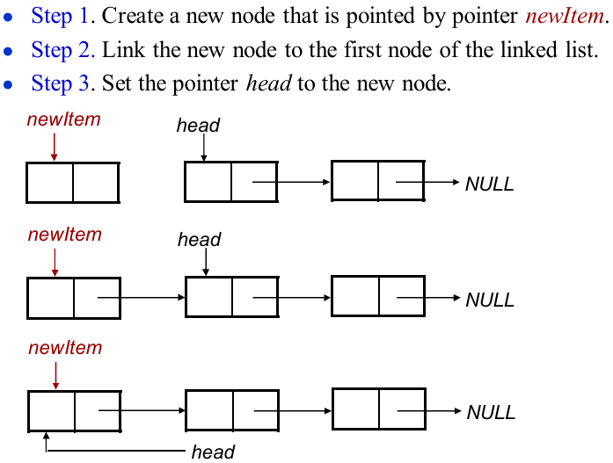
Insert First (Cont.)
Lecturer Saifur Rahman, Dept. of CSE, United International University

Slide 7
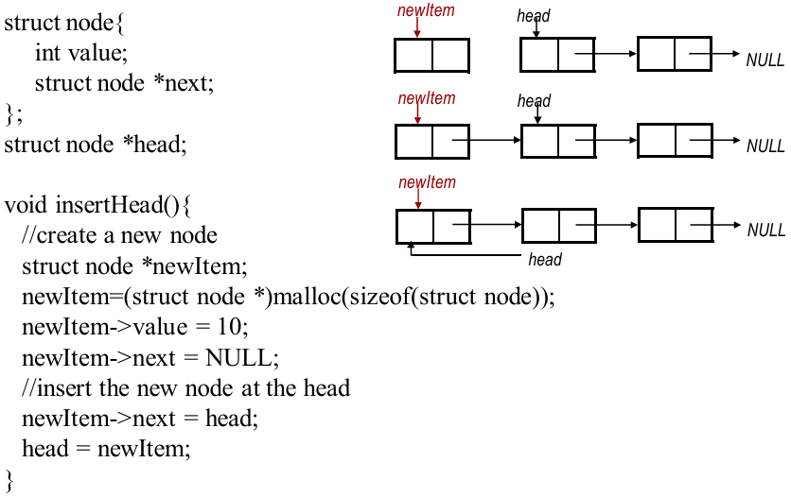
Insert First (Cont.)
Lecturer Saifur Rahman, Dept. of CSE, United International University

Slide 8
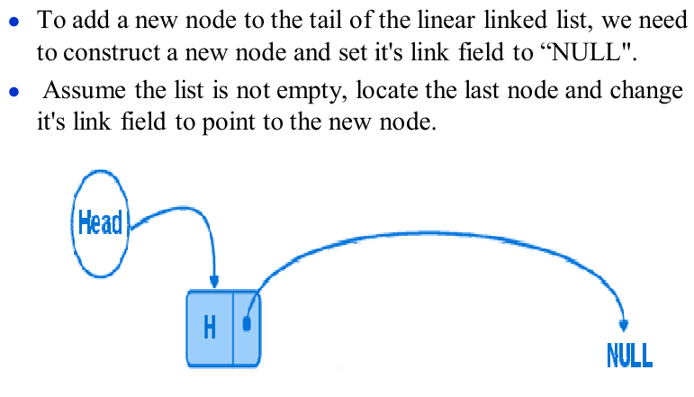
Insert Last
Lecturer Saifur Rahman, Dept. of CSE, United International University

Slide 9
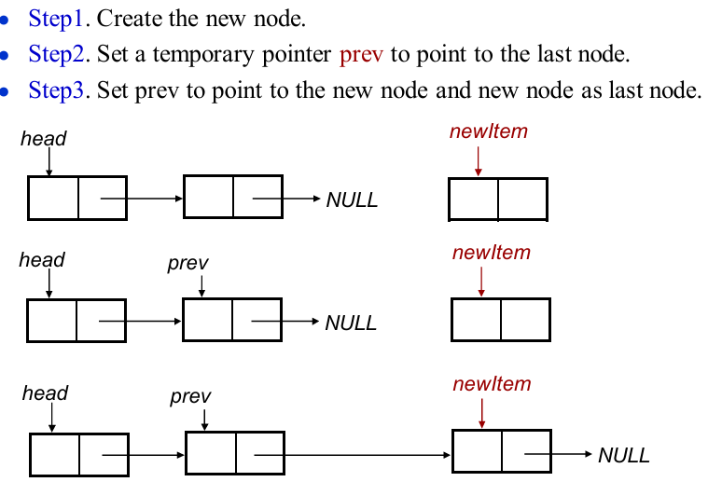
Insert Last (Cont.)
Lecturer Saifur Rahman, Dept. of CSE, United International University

Slide 10
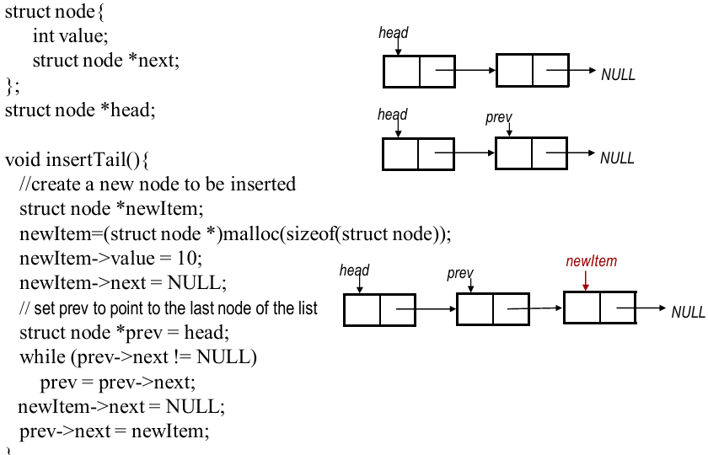
Insert Last (Cont.)
Lecturer Saifur Rahman, Dept. of CSE, United International University

Slide 11
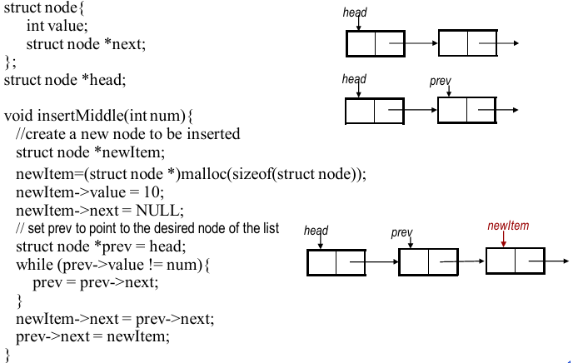
Insert Middle (after a desired node)
Lecturer Saifur Rahman, Dept. of CSE, United International University

Slide 12
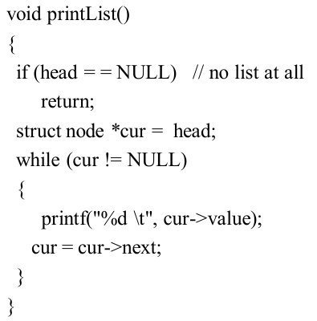
Printing List
Lecturer Saifur Rahman, Dept. of CSE, United International University

Slide 13
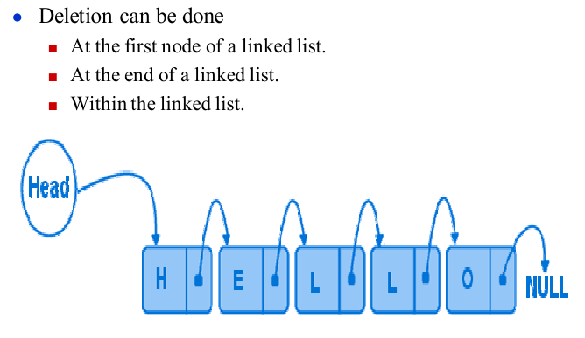
Deletion from a Linear Linked List
Lecturer Saifur Rahman, Dept. of CSE, United International University

Slide 14
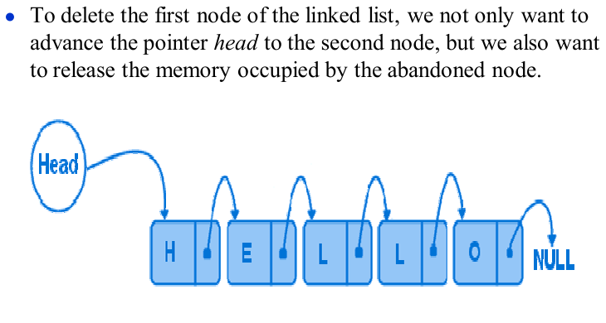
Delete First
Lecturer Saifur Rahman, Dept. of CSE, United International University

Slide 15
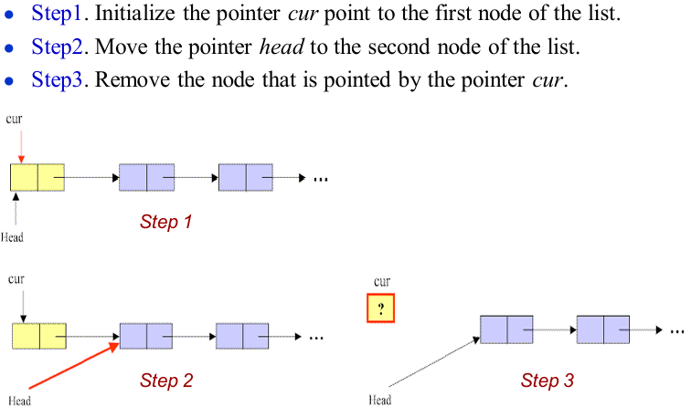
Delete First (Cont.)
Lecturer Saifur Rahman, Dept. of CSE, United International University

Slide 16
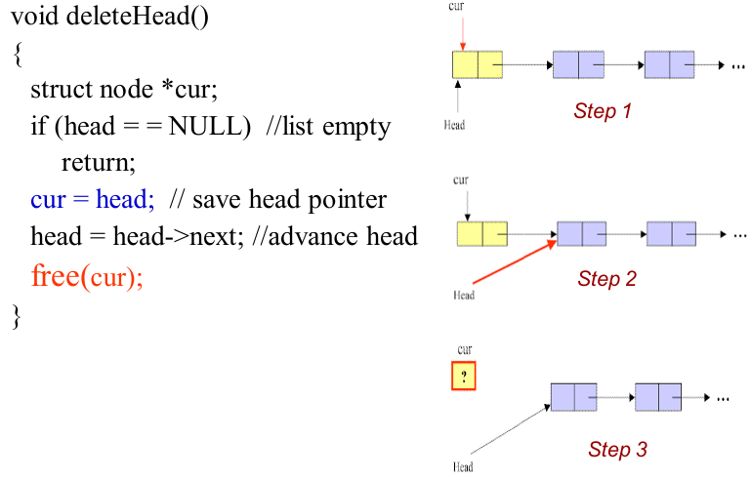
Delete First (Cont.)
Lecturer Saifur Rahman, Dept. of CSE, United International University

Slide 17
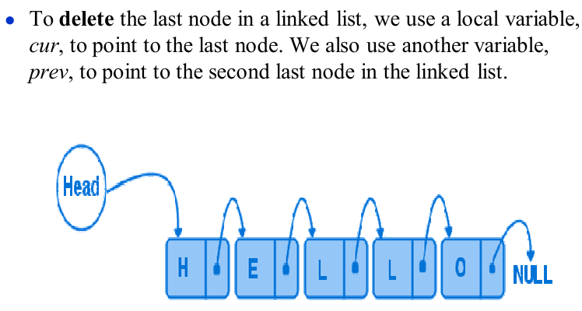
Delete Last
Lecturer Saifur Rahman, Dept. of CSE, United International University

Slide 18
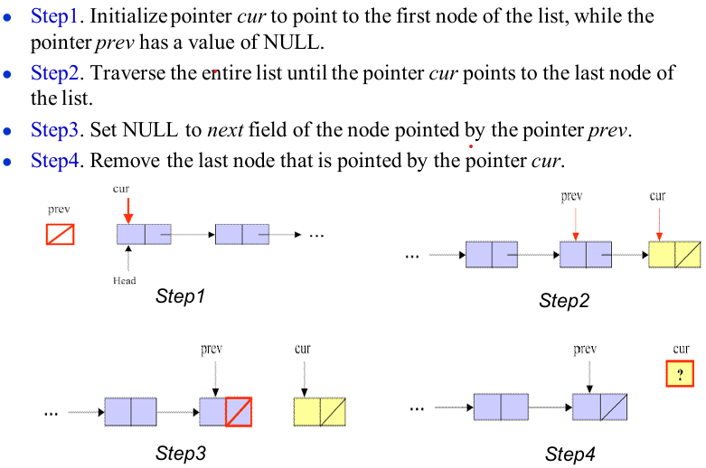
Delete Last (Cont.)
Lecturer Saifur Rahman, Dept. of CSE, United International University

Slide 19
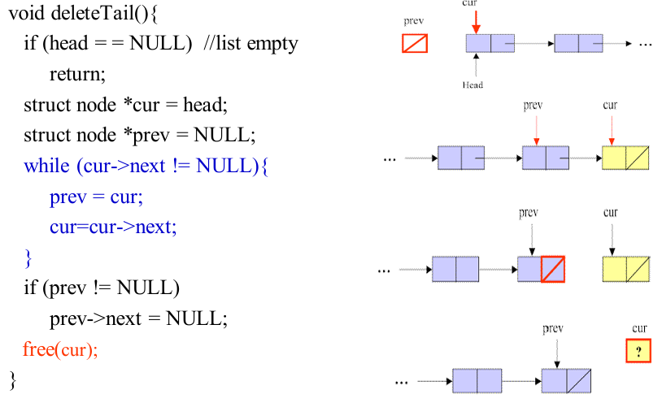
Delete Last (Cont.)
Lecturer Saifur Rahman, Dept. of CSE, United International University

Slide 20
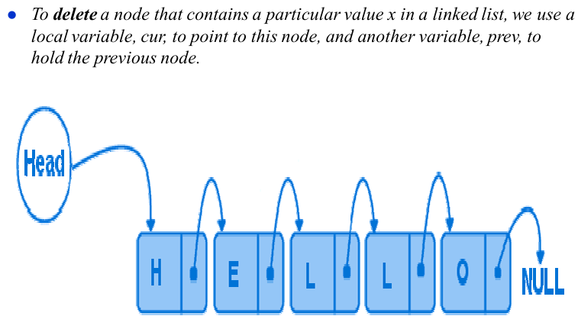
Delete Any
Lecturer Saifur Rahman, Dept. of CSE, United International University

Slide 21
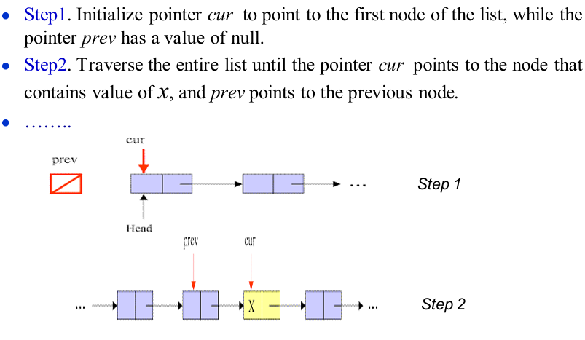
Delete Any (Cont.)
Lecturer Saifur Rahman, Dept. of CSE, United International University

Slide 22
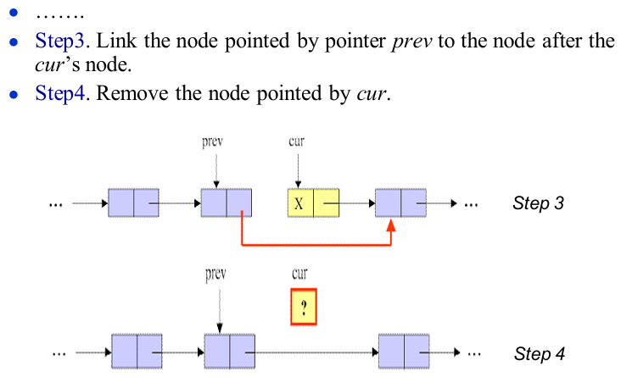
Delete Any (Cont.)
Lecturer Saifur Rahman, Dept. of CSE, United International University

Slide 23
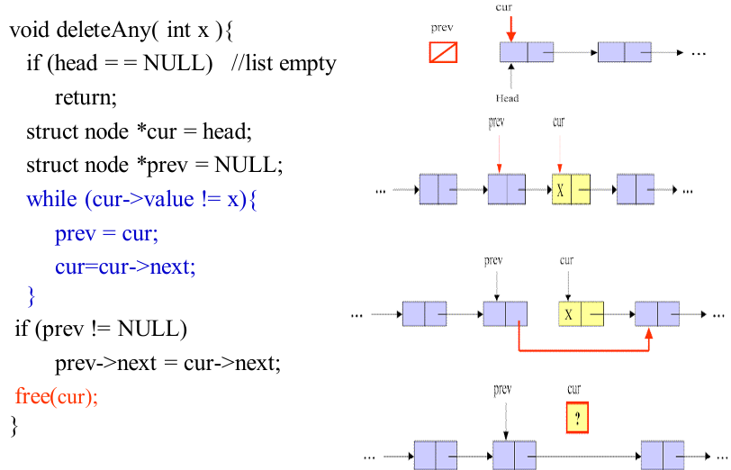
Delete Any (Cont.)
Lecturer Saifur Rahman, Dept. of CSE, United International University

Slide 24
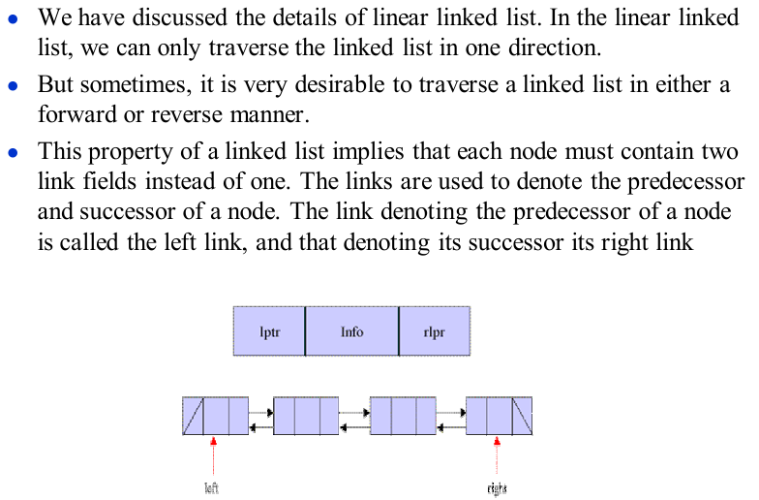
Introduction to Doubly Linked List
Lecturer Saifur Rahman, Dept. of CSE, United International University

Slide 25
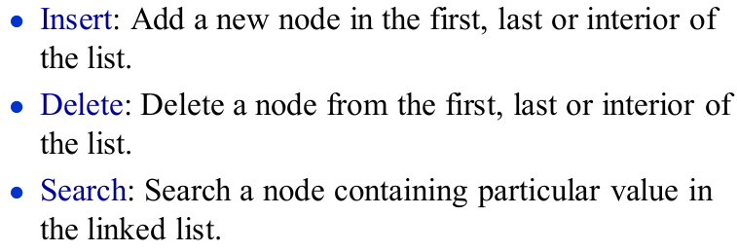
Basic Operation of Doubly Linked List
Lecturer Saifur Rahman, Dept. of CSE, United International University

Slide 26
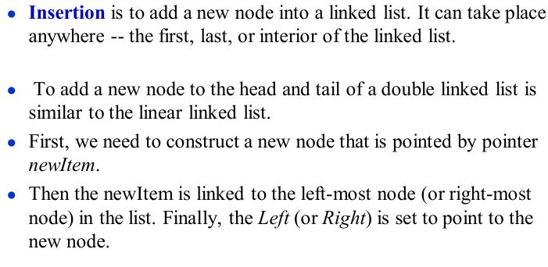
Insert First or Insert Last into a DLL
Lecturer Saifur Rahman, Dept. of CSE, United International University

Slide 27
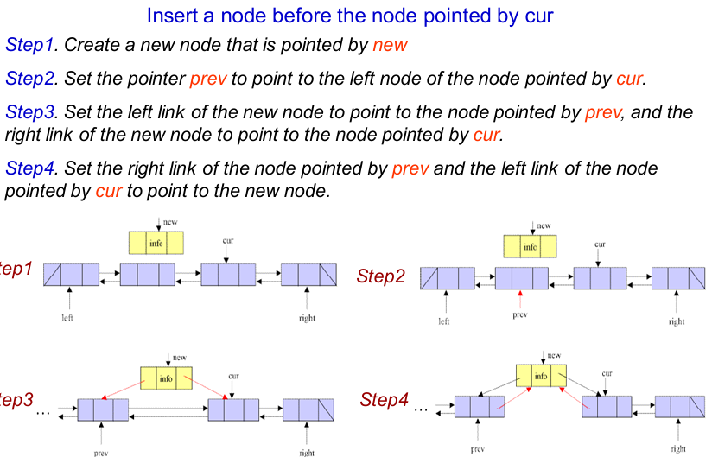
Insert Interior of Doubly Linked List
Lecturer Saifur Rahman, Dept. of CSE, United International University

Slide 28
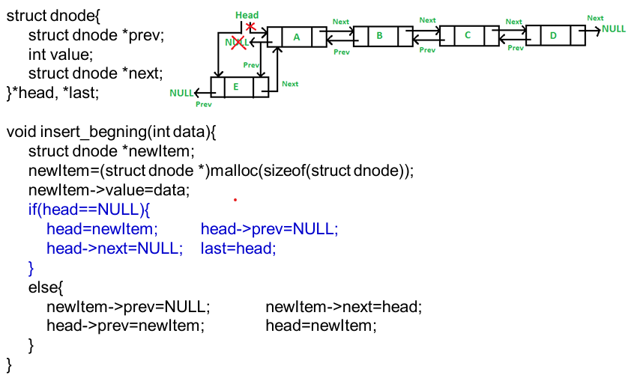
Insert (First) into a Doubly Linked List
Lecturer Saifur Rahman, Dept. of CSE, United International University

Slide 29
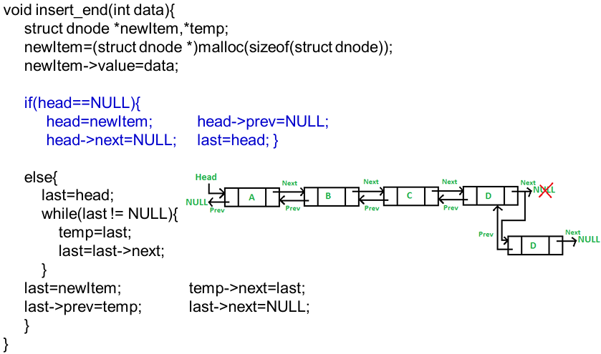
Insert (Last) into a Doubly Linked List
Lecturer Saifur Rahman, Dept. of CSE, United International University

Slide 30
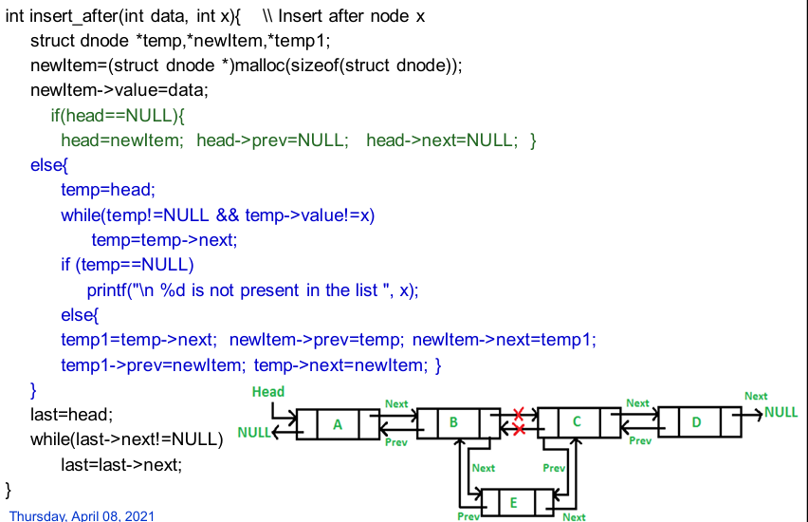
Insert (Middle) into a Doubly Linked List
Lecturer Saifur Rahman, Dept. of CSE, United International University

Slide 31
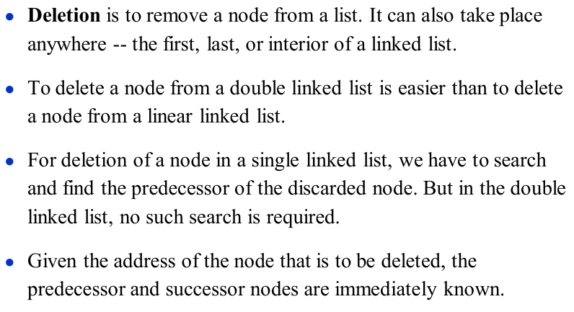
Deletion of Doubly Linked List
Lecturer Saifur Rahman, Dept. of CSE, United International University

Slide 32
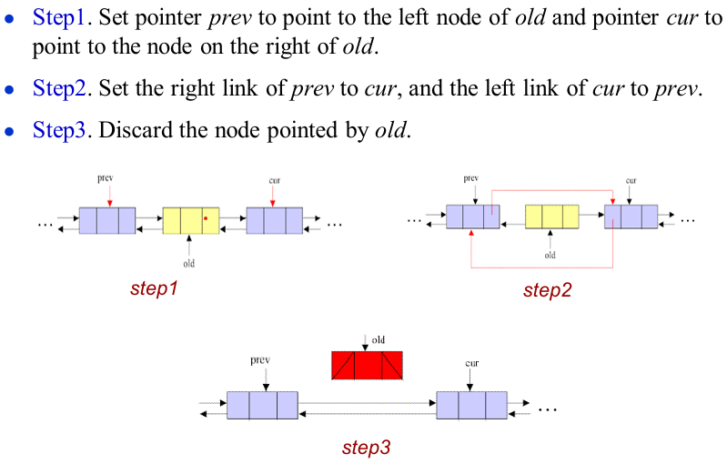
Deletion of Doubly Linked List (Cont.)
Lecturer Saifur Rahman, Dept. of CSE, United International University

Slide 33
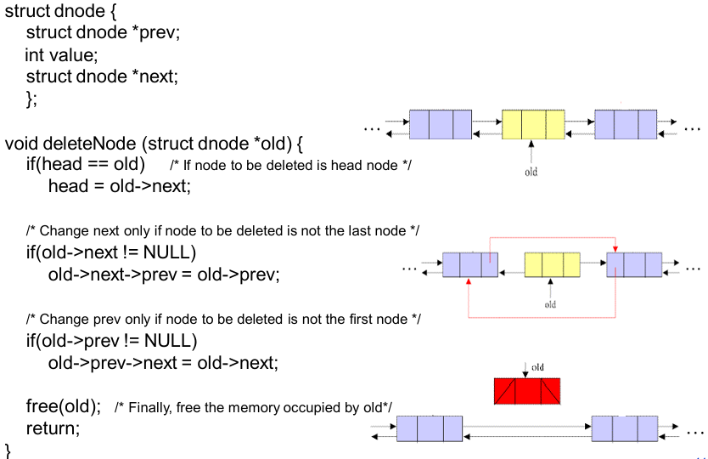
Deletion of Doubly Linked List (Cont.)
Lecturer Saifur Rahman, Dept. of CSE, United International University

Slide 34
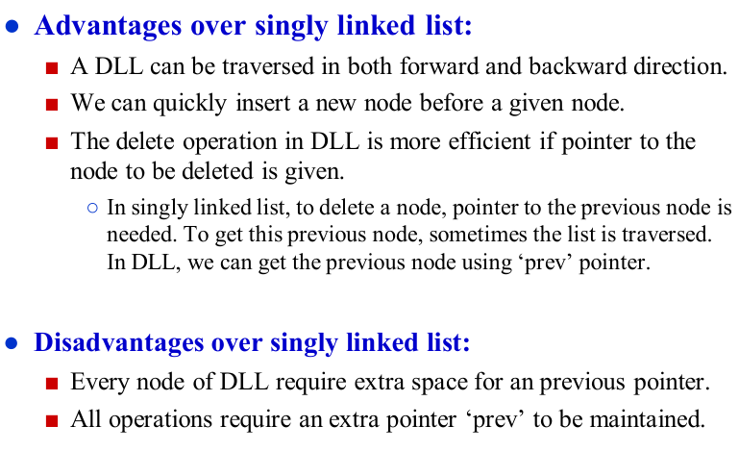
Advantages/Disadvantages of DLL
Lecturer Saifur Rahman, Dept. of CSE, United International University

Slide 35
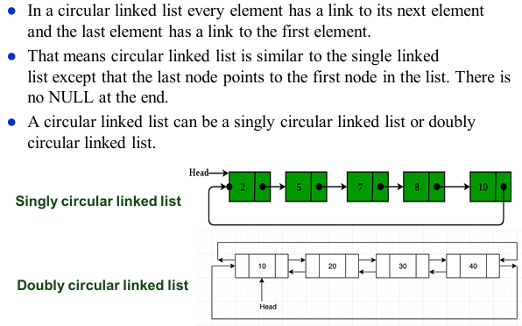
Circular Linked List
Lecturer Saifur Rahman, Dept. of CSE, United International University

Slide 36
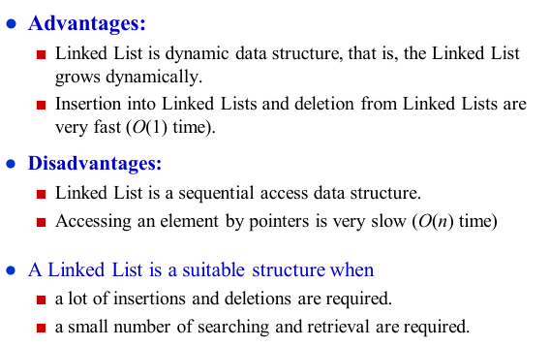
Summary on Linked Lists
Lecturer Saifur Rahman, Dept. of CSE, United International University

